Slide 1
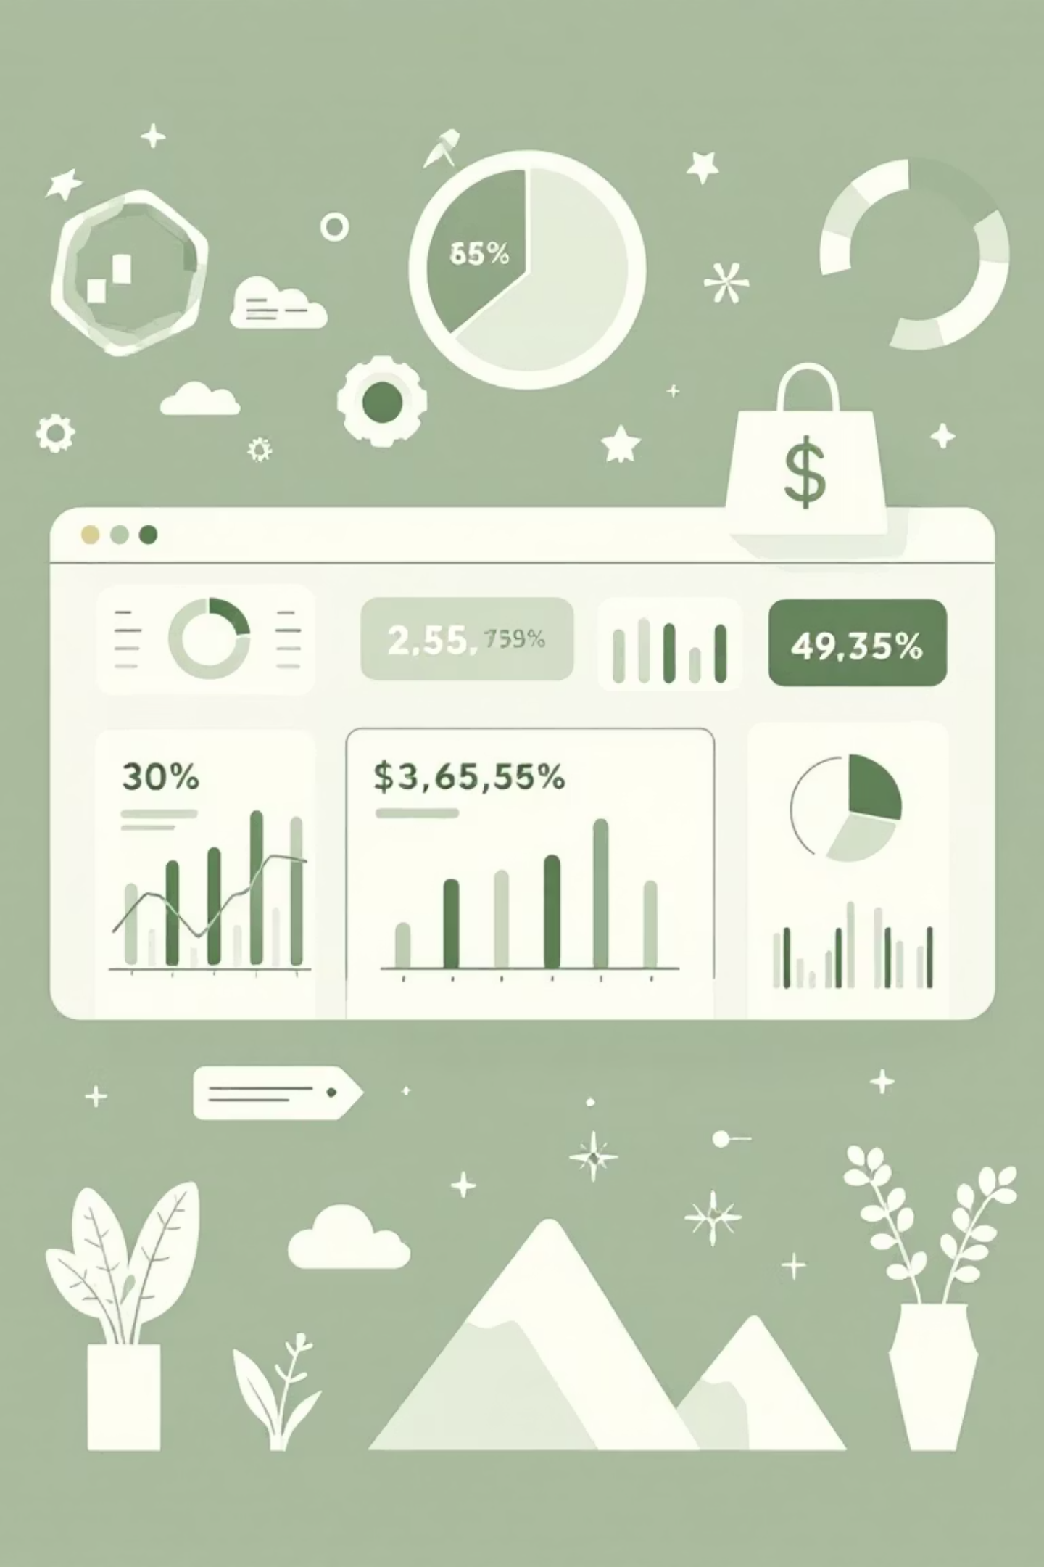
Customer Shopping Behavior Analysis
Uncovering insights from 3,900 purchases to guide strategic business decisions

Slide 2

Dataset Overview
3,900
18
50
Total Purchases
Data Columns
Locations
Transactions analyzed across all categories
Comprehensive customer and purchase attributes
Geographic diversity in customer base
25
Products
Unique items across four categories

Slide 3

Data Preparation & Cleaning
01
02
Data Loading
Missing Data
Imported dataset using pandas, explored structure with df.info() and .describe()
Imputed 37 missing Review Rating values using median by category
03
04
Feature Engineering
Database Integration
Created age_group and purchase_frequency_days columns
Connected to PostgreSQL for advanced SQL analysis

Slide 4


Revenue Insights by Gender
Male customers generate more than double the revenue of female customers, representing a significant opportunity for targeted marketing strategies.
68%
Male Customers
$157,890 total revenue
32%
Female Customers
$75,191 total revenue

Slide 5
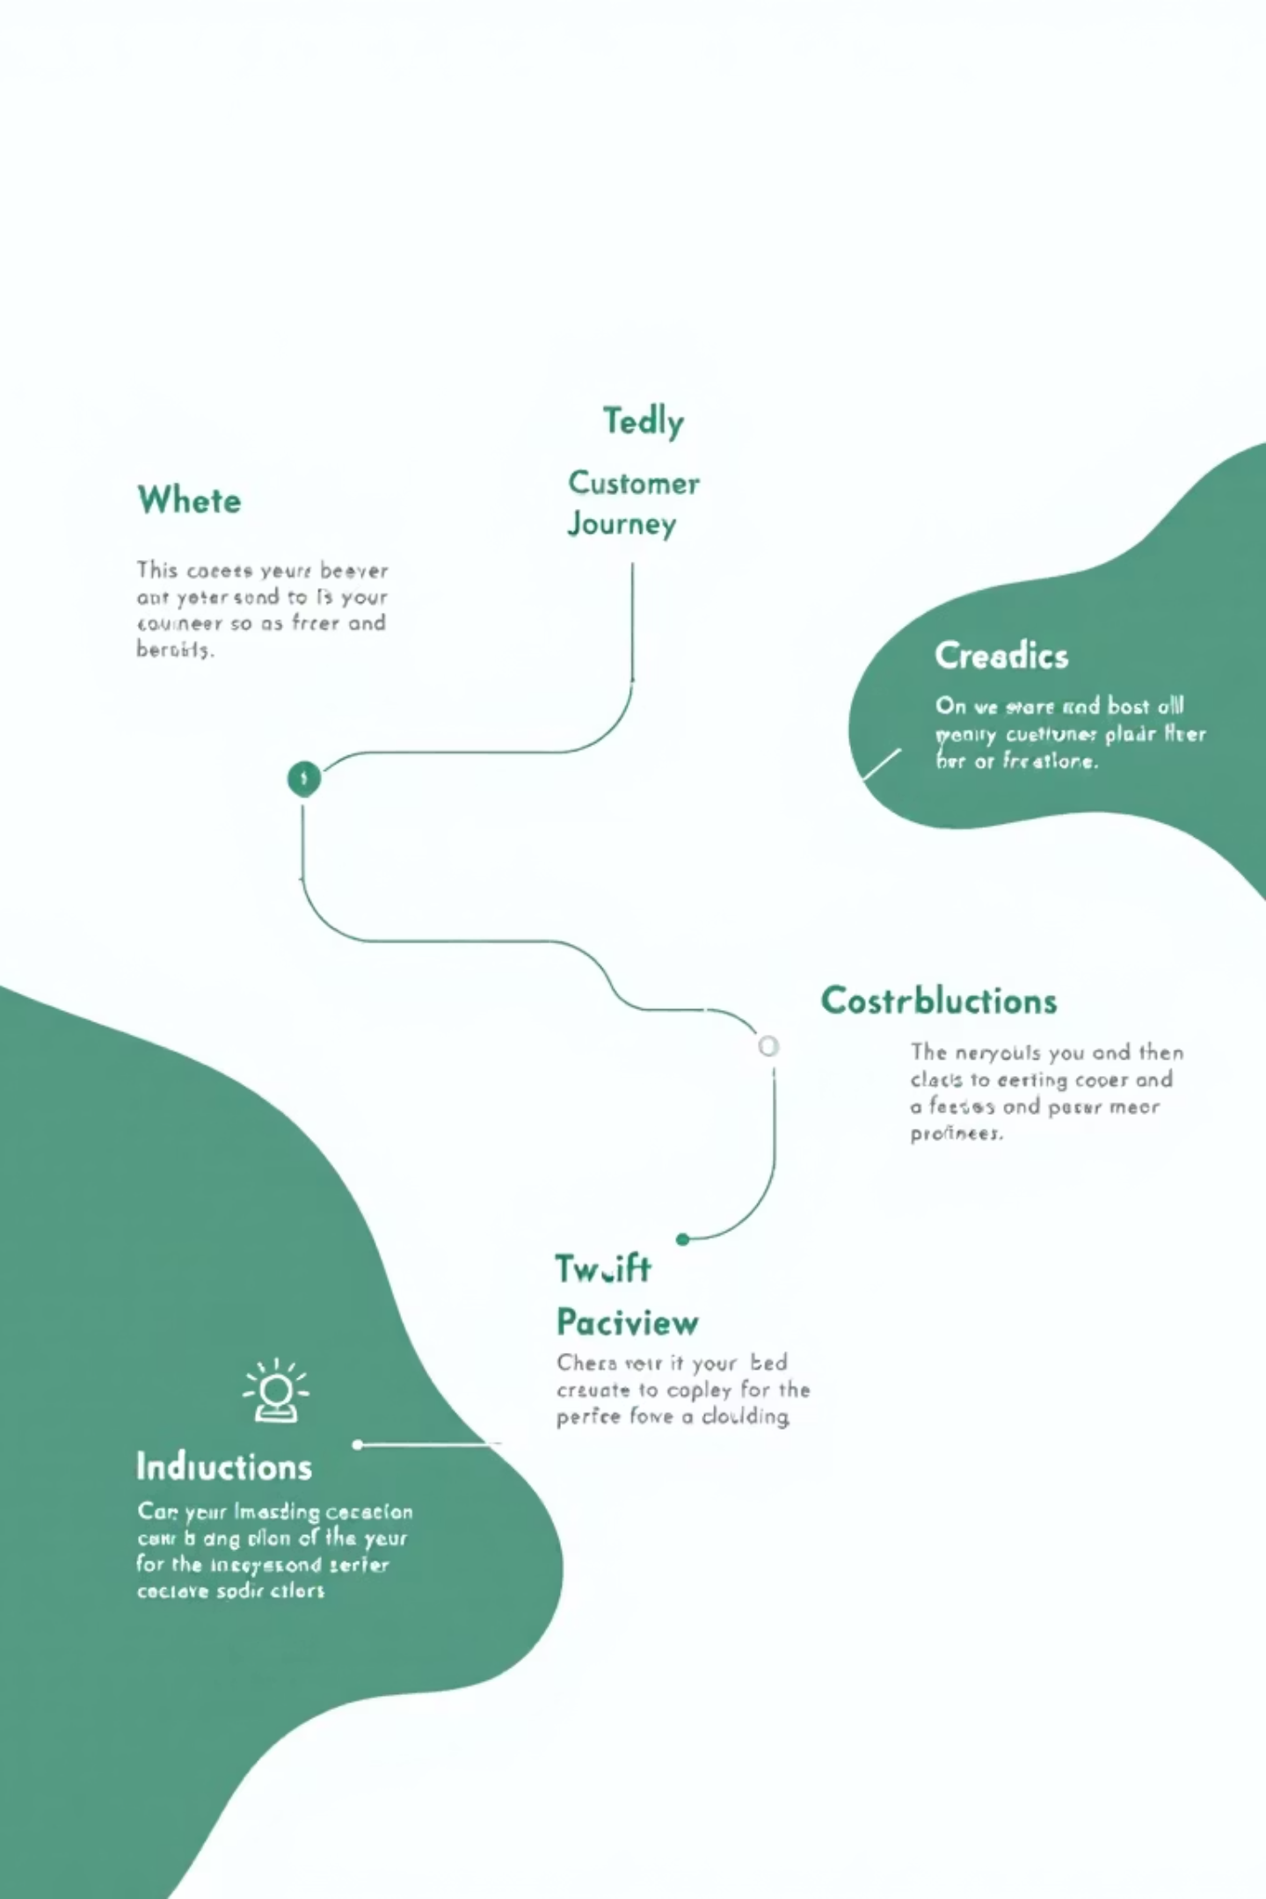
Customer Segmentation Analysis
Loyal Customers
Returning Customers
3,116 customers
701 customers
Largest segment with consistent purchase history
Growing segment showing repeat behavior
New Customers
83 customers
Smallest segment with acquisition potential

Slide 6
Top-Rated Products
1
2
3
Gloves
Sandals
Boots
Average rating: 3.86
Average rating: 3.84
Average rating: 3.82
4
5
Hat
Skirt
Average rating: 3.80
Average rating: 3.78
Highlight these products in marketing campaigns to leverage customer satisfaction

Slide 7


Subscription vs. Non-Subscription Behavior
Subscribers
Non-Subscribers
1,053 customers
2,847 customers
$59.49 average spend
$59.87 average spend
$62,645 total revenue
$170,436 total revenue
Key Finding: Similar spending patterns but subscribers represent only 27% of customer base—major growth opportunity

Slide 8
Discount Strategy Analysis
50%
49.66%
49.07%
Hat
Sneakers
Coat
Highest discount rate
48.17%
47.37%
Sweater
Pants
839 customers used discounts but spent above average—smart shoppers seeking value

Slide 9
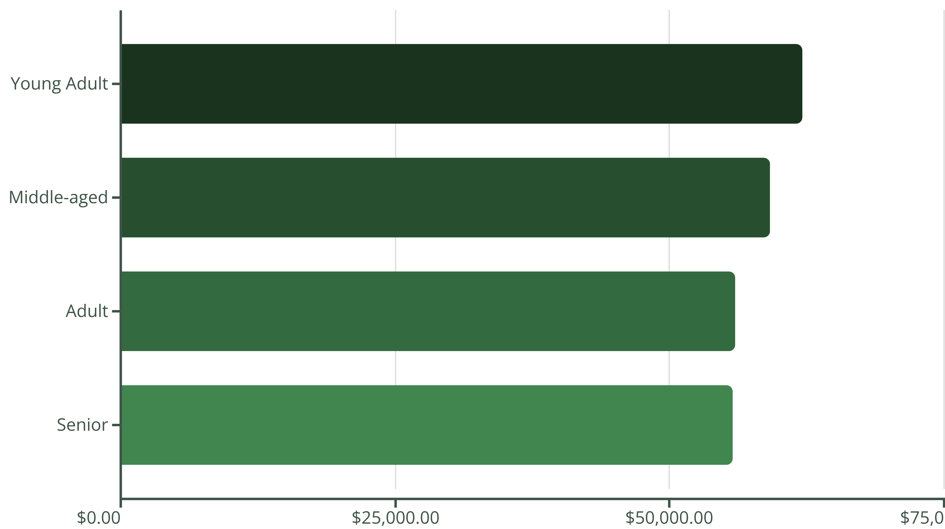
Revenue by Age Group
Young adults lead revenue generation—focus marketing efforts on this demographic

Slide 10


Strategic Recommendations
Boost Subscriptions
Promote exclusive benefits to convert non-subscribers
Loyalty Programs
Reward repeat buyers to grow loyal segment
Review Discounts
Balance sales boosts with margin control
Targeted Marketing
Focus on high-revenue age groups and top products

